Slide 1

NCCoC Quarterly Meeting Fayetteville November 2017
NCCoC Plans for 2018
Purpose:
Set Goals for 2018,9
Review Council Organization
Gather Feedback for Success

Slide 2
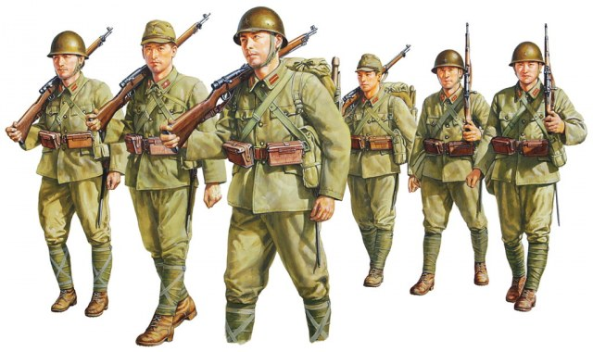
Council Organization
President
CAPT David Lee, USNR, Ret
VPs
LCOL Greg Chase, USAF, Ret (Legislative )
COL Jim Brumit, USA, Ret
CDR Ron Wilsbach, USN, Ret
Treasurer
COL Gary Marlar
Secretary and Staff
CDR Carol Alljets, USN, Ret
CPO Gary Alljets, USN
Newsletter Editor
CPT Mark Beymer, USMC
Past President, Web Master
CAPT Doug Ehrhardt, USN, Ret
Ex-Past President
COL Jeri Graham, USANC, Ret

Slide 3

Why NC Council?
NC boasts 10% of it’s working adults have a connection to the military presence in NC
There are 800,000 veterans in NC
Active duty military counts for 102,000
Bases (2015)
FT Bragg, Pope AFB 47,600
Camp Lejeune 33,500
Cherry Point 7,600
New River MCAS 5,600
Seymour Johnson AFB 4,200
US Coast Guard Base 1,600
Sunny Point Military Ocean Terminal <100
National Guard has 100 facilities 11,700
US Coast Guard Stations on NC Coast
NC Needs to Maintain It’s Military Friendly Designation

Slide 4

2018,9 Council Direction
Focus on Chapters, Membership
Decline in Membership
Losing Chapters
Continue Support of Legislative
NC Vets Initiatives
4th Branch
MOAA National
Maintain Strong Communications Processes

Slide 5

NCCoC Goals 2018, 2019
Membership
Increase Membership 10% per year
Implement Best Practice Sharing at Council Meetings
Address Succession issues
Evaluate Chapter training needs, develop plan
Organization/Communications
Organize Chapters in regional groups
Get to 80% reporting
Implement committees as appropriate
Conduct conference call Council meetings, 1/qtr
Maintain Web, Newsletters
NC Legislative
Support 4th Branch
Attend NC Legislative Vets Day
Maintain close contact with key legislative reps, through chapters
MOAA National
Attend Symposium in Columbia, SC
Storm the Hill
Respond to legislative contact requests
Maintain emphasis on 4/5 Star Chapter Recognition

Slide 6

Regional Chapter Organization
Eastern
NC02 Coastal Carolina
NC03 Eastern Carolina
NC07 SE N Carolina
NC17 First Flight
Sandhills
NC01 Cape Fear
NC06 Sandhills
NC09 Triangle
NC12 Durham Orange
Piedmont
NC04 Charlotte Metrolina
NC08 Tar Heel Central
NC14 LA Osborne Piedmont
NC20 Central Carolina
Western
NC10 Western Carolina
NC11 Catawba Valley
NC21 High Country
NC22 New River

Slide 7

Regional Groups
Sit together at Council Meetings
Share successes, issues, best practices (time provided)
Support each other with speakers, meetings, leadership
Provide reps to Council Committees
Report accountability
Council
Quarterly Reports
Officer Roster
MOAA
New Members
Officer Roster

Slide 8
From LTCOL Greg Chase, USAF, Ret
We took an oath to serve our country and our comrades. We have an obligation to continue doing so with whatever gifts we are given. The hardest part of our jobs will be to convince others to join the fight and continue the legacy started in the Revolutionary War by Deborah Sampson, from my home town, Plympton, MA. She dressed as a young soldier was wounded in the leg and shoulder in different battles and only discovered to be a female, because after treating herself, the wounds became infected and she was hospitalized. Although commended for her service, she was soon discharged.
After the War, like many soldiers of the revolution, Sampson had difficulty trying to obtain a pension. After she campaigned unsuccessfully to secure a pension in 1790, she was finally awarded a pension in 1805, and eventually won a general service pension in 1821. Sampson died of yellow fever in April of 1827.
Her example typifies the ongoing battle to obtain and retain fair compensation and benefits for all who serve. As officers in the nation's largest and most influential association of military officers, we must continue to prosecute these efforts on behalf of those officers and enlisted who either cannot or will not speak up for themselves. We must gain ground and certainly not lose any more to politicians who would much prefer to use the taxpayers’ dollars to benefit more of their constituents rather than the country as a whole. If we don’t properly take care of our service members we will not have a military for very long, and without a strong military we cannot remain a sovereign nation.
The sad part is that most people know this, but few will act on it.
Thank you for letting me bend your ear.
Greg

Slide 9
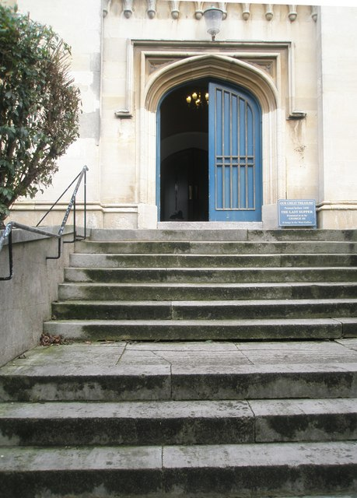
Next Steps
Let me know about Change of Command Meetings
Keep issues and successes current and open
Recruit, recruit

Slide 10

Questions?

